Slide 1
COMP 2310 Data Structures and Algorithms
Lecture 4
Stacks

Slide 2

How can you remove the 4th stone ?

Slide 3
Linear Data Structures: Stacks
Linear data structure: Data elements are in sequential order →One follows the other physically or logically.
Examples: Arrays, stacks, lists, queues.
A stack is a very common abstract data type that insertions and deletions can be made only at one end.
This end is called the top of stack. Storing and retrieving data is performed only at the top position.

Slide 4

Stack Operations
Consider a physical analogy: A stack (Pile) of books. We can do the following set of things with this stack:
Add a New book: Place a book on the top.
Check to see if we have space for adding more books.
Remove one book off the top.
Remove all books: Empty the stack.
A stack of books

Slide 5
Abstract Data Type: Stack
A finite number of objects
Having the same data type
Ordered by when they were added
A set of operations
Note that ADT Concerns only on the concept or model, it does not concern implementation details
When we define implementation details it becomes a data structure.

Slide 6
Stack Operations
We have stack functions that perform the following operations:
create() : Create an empty stack
push(x) : Put x on top of the stack.
pop() : Remove top element of the stack
clear() : Clear (destroy) the stack.
isEmpty() : Check to see if the stack is empty.
isFull() : Check to see if the stack is full.
Notes:
6

Slide 7
Stack Sructure
Since the contents of a stack data structure are stored in linear form → Linear data structure
Arrays are also linear structures and any element in an array can be accesed directly.
But in stacks we can only access the top element.
The elements of a stack move according to LIFO principle:
Last In Fist Out (Or FILO)
Notes:
7

Slide 8

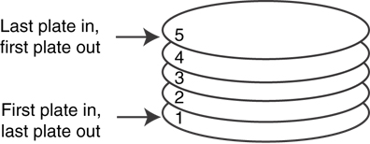
A LIFO Structure
A stack of plates :

Slide 9
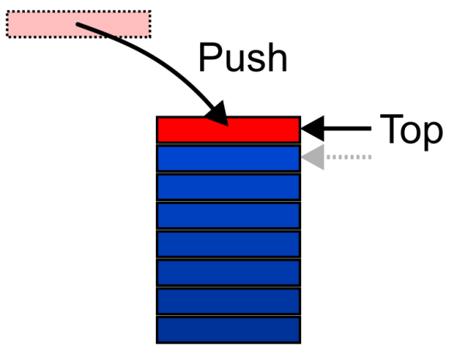
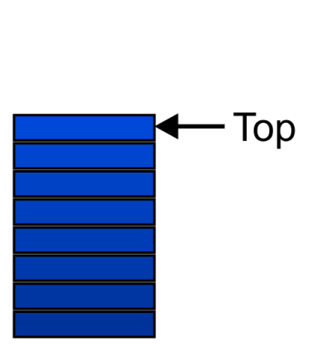
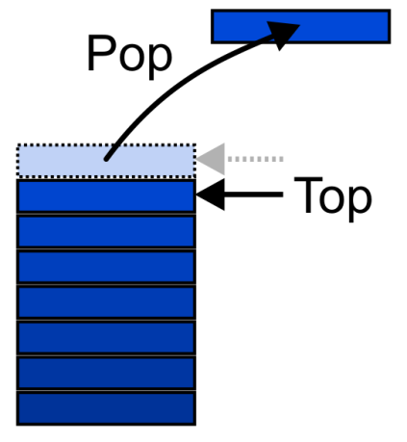
Stack Operations: LIFO
Graphically, we may view these operations as follows:

Slide 10
Stack Operations: Illustration
stack empty
stack.push(A)
A
top
B
top
stack.push(B)
A
letter=stack.pop()
A
top
C
top
stack.push(C)
A
Notes:
10

Slide 11
Implementation of stack structures An array can be used to implement stack structure:
Consider an array of characters called contents and size of 4.
Getting first A and then B into the stack will be represented in an array as in the figure.
→contents[0]=A, contents[1]=B,…
0 1 2 3
contents
B
A
Notes:
11

Slide 12
Array implementation of stacks
1
We need to keep track of the top of the stack since not all of the array holds stack
elements (Part of it is empty)
We use an integer, top, which will hold the array index of the element at the top of the stack.
top
contents
0 1 2 3
B
A
Notes:
12

Slide 13
Array implementation of stacks: Pop
Results of a sequence of pop operations
top=-1 when stack is empty
2
1
0
-1
C
top
top
top
top
index
index
index
index
0 1 2 3
0 1 2 3
0 1 2 3
0 1 2 3
B
B
A
A
A
Initial stack
1) stack.pop()
2) stack.pop()
3) stack.pop()
Notes:
13

Slide 14
Array implementation of stacks: Push
Suppose stack capacity is 4.
Continue with the following push operations
1) stack.push(D)
2) stack.push(E)
3) stack.push(F)
3) stack.push(G)
top=3 when stack is full
0
1
2
G
3
top
top
F
top
F
top
index
index
index
index
0 1 2 3
0 1 2 3
0 1 2 3
0 1 2 3
E
E
E
D
D
D
D
stack.push(D)
stack.push(E)
stack.push(F)
stack.push(G)
Notes:
14

Slide 15
Array implementation of stacks: Disadvantage
If we try to push the letter H the stack will not accept it since it is full.
A major disadvantage of using static arrays!
We need to be able to decide the maximum size of the stack at run time.
We must use a pointer to a dynamically-allocated array instead of a regular array.
Notes:
15

Slide 16
Array implementation of Stacks: IsFull
Suppose that we implement a stack of at most n elements with an array S.
IsFull ()
if top ≥ n-1
return TRUE
else
return FALSE
Notes:
16

Slide 17
Array implementation: IsEmpty
// Is the stack empty?
IsEmpty()
if top = -1
return TRUE
else
return FALSE
Notes:
17

Slide 18
Array implementation: Push
//The new value x is pushed (added) to the top of S
Push(x)
if IsFull()
error “Stack is full”
else
top ← top+1
S[top] ← x
Notes:
18

Slide 19
Array implementation: Pop
//The top element in S is removed and sent to call point
Pop()
if IsEmpty()
error “Stack is empty” //Exit
else
top ← top-1
Complexities of stack operations: Assume n elements
Filling the stack : O(n)
Emptying the stack : O(n)
Stack push and pop : O(1)
Notes:
19

Slide 20
Stack Applications
There are many computer related application areas of stacks.
In this sections we present the following problems that can be solved by using stacks.
Reversing a word or text.
Balancing symbols in an expression.
Infix to postfix conversion.
Evaluating postfix expressions.
……………………….
Notes:
20

Slide 21
Reversing a word
We want to reverse a given word using a stack.
EX : STACK → KCATS
Solution Method:
First the characters are extracted one by one from
the input string
Next they are pushed onto the stack.
Then they’re popped off the stack and displayed.
Notes:
21

Slide 22
Pseudocode for Reversing a Word
// Uses two functions: char_at_ pos_i and display
S ← createStack( )
ReverseWord(W)
for (i ← 0 to lengthOfW-1) do
ch ← char_at_ pos_i
Push(ch )
for (j ← lengthOfW-1 to 0) do
display S[j]
Pop()
Notes:
22

Slide 23
Reversing a word
Example: Trace of the algorithm that checks for reversing the word “hello”
Extract the characters and push them to the stack. Then pop stack contents
Push h
Push e
Push l
Push l
Push o
Pop o
Pop l
Pop l
Pop e
Pop h
hello
h
e
h
l
e
h
l
l
e
h
o
l
l
e
h
l
l
e
h
l
e
h
e
h
h
Display :
o
l
l
e
h
Notes:
23

Slide 24
Balancing Symbols in Expressions
Searching for syntax errors in a computer program is a common problem.
Every left bracket must be paired with its right counterpart.
For example, the sequence ((( )) is wrong whereas the sequence ((( ))) is correct.
For simplicity, we check for balancing of parantheses and ignore any other character in the algorithm fragment.
A simple solution to this problem: Use stacks.
Notes:
24

Slide 25
How to Check Balance ?
([]({()}[()])) is balanced; ([]({()}[())]) is not.
Simple counting is not enough to check balance
You can do it with a stack: going from left to right
If you see a (, [, or {, push it on the stack
If you see a ), ], or }, pop the stack and check whether you got the corresponding (, [, or {
When you reach the end, check the stack state:
Stack is empty → Balanced
Stack is not empty → Not balanced Example: Input: exp = “[()]{}{[()]()}”
Output: Balanced
Input: exp = “[ ( ] )”
Output: Not Balanced

Slide 26
Balancing Symbols in Expressions: Algorithm
Steps of the algorithm:
Start with an empty stack
Read all characters until the end of the expression
Push the character onto the stack if it is an opening symbol.
If it is a closing symbol, pop the stack. At any point, if the stack becomes empty while there is a closing symbol report an error.
If the symbol just popped does not match with a closing symbol then report an error.
When end-of-expression is reached, if the stack is not empty, report an error.
Notes:
26

Slide 27
Example: Pseudocode for Balancing Symbols
//Algorithm checks balance for only braces : { , }. More symbols can be added
S ← createStack( ) // str is the expression string
CheckBalance (str)
balanced ←TRUE
i ← 0
while (balanced and i< lengthOfstr) do
ch ← str(i)
i ← i+1
if ch ="{"
Push({ )
else if ch ="}" do
if IsEmpty() = FALSE and S(top)== "{" //No problem
Pop()
else
balanced ←FALSE // Not balanced
If balanced and IsEmpty()
return TRUE // String is balanced
else
return FALSE // String is not balanced
Notes:
27

Slide 28
Balancing Symbols in Expressions
Trace of the algorithm that checks for the balanced braces in the
expression:
{a { b } c}
{
{
{
{
Push {
Push {
Pop
Pop
Stack is empty, braces are balanced.
Notes:
28

Slide 29
Balancing symbols
Trace of the algorithm that checks for the balanced braces:
{a { b c}
{
{
{
{
Push {
Push {
Pop
Stack is not empty, braces are not balanced.
Notes:
29

Slide 30
Evaluating Expressions: Different Notations
Is it possible to simplify expression evaluation by removing parantheses?
Consider the expression: 5*(8+9)
This form of expression is called the infix form
Programming language compilers use another form for evaluating expressions: The postfix form.
(Another variation is called prefix form)
Expressions in postfix form are easier for a computer to evaluate than expressions in infix form.
→No need for parantheses !
What is postfix form and how can we convert an expression from infix to postfix form?
Notes:
30

Slide 31
Infix and Postfix Forms
5 + 8*9 Expression is in Infix form: Result=77
Consider this ordering:
5 8 9 * + Expression in postfix form: Result=77
In general we have :
Infix form: Operand, operator, operand→ a / b , a+b , …
Postfix form: Operand, operand, operator→ a b / , ab+, …
Notice that the order of operands remain the same!
For evaluating infix we need to know precedence of the operators.
Notes:
31

Slide 32
Infix and Postfix Forms
Evaluating Postfix for 5 + 8*9 :
An operator in a postfix expression applies to two operands that immediately preceed it:
5 8 9 * + → 5 72 + → 77 ________
Notes:
32

Slide 33
Infix to postfix conversion rules:
Precedence of the operators:
1. ( ) highest
2. * /
3. + - lowest
No two operators with the same precedence can be placed one after another in the stack
An operator of low precedence cannot be pushed onto an operator of high precedence
Notes:
33

Slide 34
Infix to postfix conversion:
Infix expression Postfix expression If parantheses exist in infix expression:
Start from the innermost parenthesis and move outward by handling
parantheses one by one.
Apply precedence rules to operators.
a+(b+c)
abc++
(a+b)+c
ab+c+
a-b*c
abc*-
(a/b)*(c/d)
ab/cd/*
a/(b+c*d-e)
abcd*+e-/
a-b*c+d/e
abc*-de/+
Notes:
34

Slide 35
Postfix Expressions: Examples
Infix | Postfix | Value
5 + 4 | 5 4 + | 9
5 + 4 * 2 | 5 4 2 * + | 13
(5 + 4) * 2 | 5 4 + 2 * | 18
6* ( (5+ (2+3) *8 )+3) | 6523+8*+3+* | 288

Slide 36
Converting Infix to Postfix Form: Algorithm
Steps of the conversion algorithm:
Start with an empty stack
Place an operand onto the output when it is read. (Finally, Output will contain the postfix form.)
Push an operator (except the right paranthesis) onto the stack when it is read. If the incoming symbol has higher precedence than the top of the stack, push it on the stack.
Pop the stack when a right paranthesis is encountered writing all symbols onto the output until a matching left paranthesis is seen and pop and discard this paranthesis.
If one of the symbols +,*, - , /,( is seen, pop entries from the stack until an entry of lower priority is found.
If end of the input is reached pop the stack until it is empty, writing symbols onto the output (Discard the pair of parentheses).
Notes:
36

Slide 37
Infix to postfix conversion: Example
Assume the operators are : +, *, ( )
Convert the following infix expression into postfix form.
E=a+b*c+(d*e+f)*g
Notes:
37

Slide 38
Infix to postfix conversion: Pseudocode
s ←createStack Postfix(expr) //expr : Given expression in infix form
while(more symbols)
x←next symbol // Extract next symbol from expr
if(x == operand )
output x //Append to output string
else
while(precedence(x) <= precedence(top(s)))
output (pop()) //Except brackets
push(x) //Push x to stack s
while(! isEmpty())
output(pop()) //Remaining stack contents,except (
//Output will be the postfix expression now.

Slide 39
Infix to postfix conversion: Example
E= a+b*c+(d*e+f)*g
Conversion order :
Output a
Push +
Output b
What to do with * ?
output
+
a b
stack
Notes:
39

Slide 40
Infix to postfix conversion
a+b*c+(d*e+f)*g
since the symbol + (top entry) has lower precedence than *, * is pushed onto stack.
Next, c is output
*
output
+
a b c
stack
Notes:
40

Slide 41
Evaluating postfix expressions
E= a+b*c+(d*e+f)*g
What to do with + ? Since + has lower precedence than *, * is popped from stack.
The previous + , which has not lower but equal priority, + is also popped. * and + are put on the output.
Then next (second) + is pushed
output
+
a b c * +
stack
Notes:
41

Slide 42
Infix to postfix conversion
a+b*c+(d*e+f)*g
Next symbol ( has the highest precedence, so it is pushed onto the stack.
Next, d is output.
(
output
+
a b c * + d
stack
Notes:
42

Slide 43
Infix to postfix conversion
a+b*c+(d*e+f)*g
Next symbol *. Don’t pop (, it stays in the stack until the closing bracket is read.
Push * , place e on the output.
*
(
output
+
a b c * + d e
stack
Notes:
43

Slide 44
Infix to postfix conversion
a+b*c+(d*e+f)*g
Next, + is read, * is popped and output (It has higher priority than +)
Then + is pushed and f is output.
+
(
output
+
a b c * + d e * f
stack
Notes:
44

Slide 45
Infix to postfix conversion
a+b*c+(d*e+f)*g
) is read, stack popped back until the opening ( .
output +
output
+
a b c * + d e * f +
stack
Notes:
45

Slide 46
Infix to postfix conversion
a+b*c+(d*e+f)*g
* is read, pushed onto the stack and g is output.
*
output
+
a b c * + d e * f +g
stack
Notes:
46

Slide 47
Infix to postfix conversion
a+b*c+(d*e+f)*g
End of the input is reached.
Pop and output remaining symbols * and + from the stack.
Output string is now in postfix form.
output
a b c * + d e * f +g * +
stack
Notice that the postfix form does not include parentheses.
Notes:
47

Slide 48
Another Example
Expression:
A * (B + C * D) + E
becomes
A B C D * + * E +
 | Current symbol | Operator Stack | Postfix string
1 | A |  | A
2 | * | * | A
3 | ( | * ( | A
4 | B | * ( | A B
5 | + | * ( + | A B
6 | C | * ( + | A B C
7 | * | * ( + * | A B C
8 | D | * ( + * | A B C D
9 | ) | * | A B C D * +
10 | + | + | A B C D * + *
11 | E | + | A B C D * + * E
12 |  |  | A B C D * + * E +

Slide 49
How do Compilers Evaluate Expressions?
A compiler which translates a program, has to generate machine instructions to evaluate expressions.
Stacks are used by compilers to evaluate expressions and generate machine code.
Compiler first converts each infix expression into postfix form.
The reason is that, postfix expressions are parenthesis-free and precedence rules are not needed for evaluation.
The internal evaluation of expressions is performed on the postfix form in just one pass.
The complexity is linear time, n is the expression length.
Notes:
49

Slide 50
Evaluating Postfix Expressions
Numeric postfix expressions can be evaluated by using stacks as follows:
When a number is seen it is pushed onto the stack
When an operator is seen it is applied to two preceeding numbers in such a way that these numbers are popped and the corresponding result is pushed on to the stack.
Notes:
50

Slide 51
Evaluating Postfix Using Stacks: Algorithm
Informal algorithm:
Read all the symbols in the given Postfix Expression one by one from left to right
If next symbol is operand, then push it on to the Stack.
If next symbol is operator, then perform TWO pop operations and store the two popped operands in two different variables: operand1 and operand2.
Perform the operation using operand1 and operand2 and push result back on to the Stack.
Finally perform a pop operation and display the popped value as the final result.

Slide 52
Algorithm for Evaluating a Postfix Expression
S ←createStack
EvalPostfix(Expression)
symb ←next symbol // Next symbol is extracted from postfix expression
WHILE (more symb)
{
If symb is an operand
then push (symb)
else //symbol is an operator
{
Opnd1=pop();
Opnd2=pop();
value = result of applying symb to Opnd1 & Opnd2
Push(value)
}
}
Result = pop () //The last value in the stack is the result of expression

Slide 53
Evaluating Postfix Expressions:Example
Evaluating a numeric expression using stacks:
Infix: expression = 6*((5+(2+3)*8)+3), Convert to postfix
Postfix : expression= 6523+8*+3+*
3
3
numbers before + are pushed onto the stack
2
top
5
6
Notes:
53

Slide 54
Evaluating postfix expressions
Expression: 6523+8*+3+*
2
Next is operator +. 3 and 2 are popped and their sum 5 is pushed onto the stack (The order: 2+3)
5
top
5
6
Notes:
54

Slide 55
Evaluating postfix expressions
Expression: 6523+8*+3+*
8
3
Next operand 8 is pushed onto the stack. Next operatr is *
5
top
5
6
Notes:
55

Slide 56
Evaluating postfix expressions
Expression: 6523+8*+3+*
2
8 and 5 are popped, * is applied and their product 40 is pushed
40
top
5
6
Notes:
56

Slide 57
Evaluating postfix expressions
Expression: 6523+8*+3+*
1
40 and 5 popped, + is applied and their sum 45 is pushed
top
45
6
Notes:
57

Slide 58
Evaluating postfix expressions
Expression: 6523+8*+3+*
2
3 is pushed
3
top
45
6
Notes:
58

Slide 59
Evaluating postfix expressions
Expression: 6523+8*+3+*
1
3 and 45 popped, + is applied and their sum is pushed
top
48
6
Notes:
59

Slide 60
Evaluating postfix expressions
Expression: 6523+8*+3+*
0
48 and 6 are popped, * is applied and their product is pushed. Stack now contains one element. This is the result.
top
288
Notes:
60

Slide 61
Evaluating postfix expressions: Complexity
Running time for evaluating postfix expression is O(n).
Because we are running a single stack whose size is n.
n is determined by the number of operands and operators in the expression.
Notes:
61

